Slide 1
Death-on-FHIR
Leveraging Open APIs to Track Fatalities in Real-Time to Support Public Health Surveillance and Response

Slide 2
Team Contributions
Paula Braun (SME)
Public-Health implications
Co-Designer
Sam Cantrell (Developer)
Data Conversion
Content-Based Router
Guy Garnett (Developer)
Co-Designer
Test Endpoints
Neeraja Lakshmipathy (Developer)
User Interface
Content-Based Router
Sujan M Shakya (Developer)
User Interface

Slide 3
Leverage Open API-Based Tools to Help Our
State and Local Partners
Respond to
Health Threats
Such as the
Opioid Epidemic

Slide 4
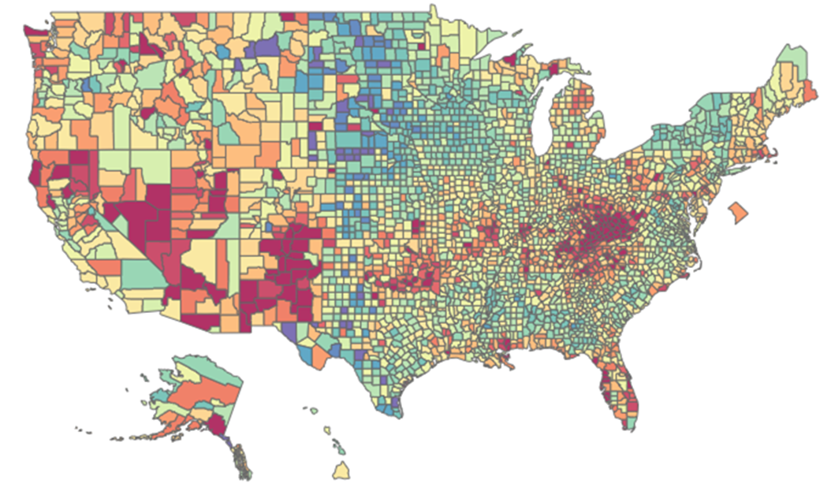
Help Track Fatalities in Real-Time

Slide 5
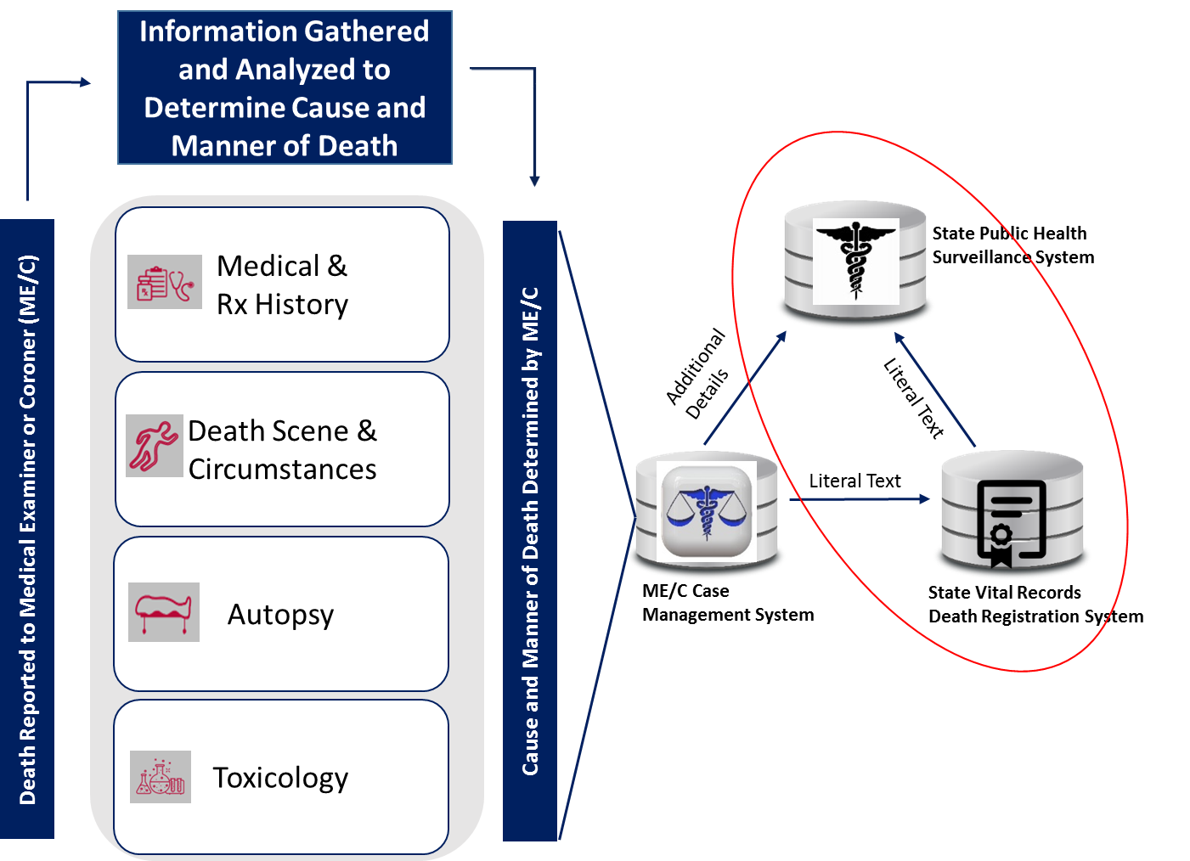
Use Case 1: Report Fatalities in Real-Time from State EDRS to State BioSense

Slide 6
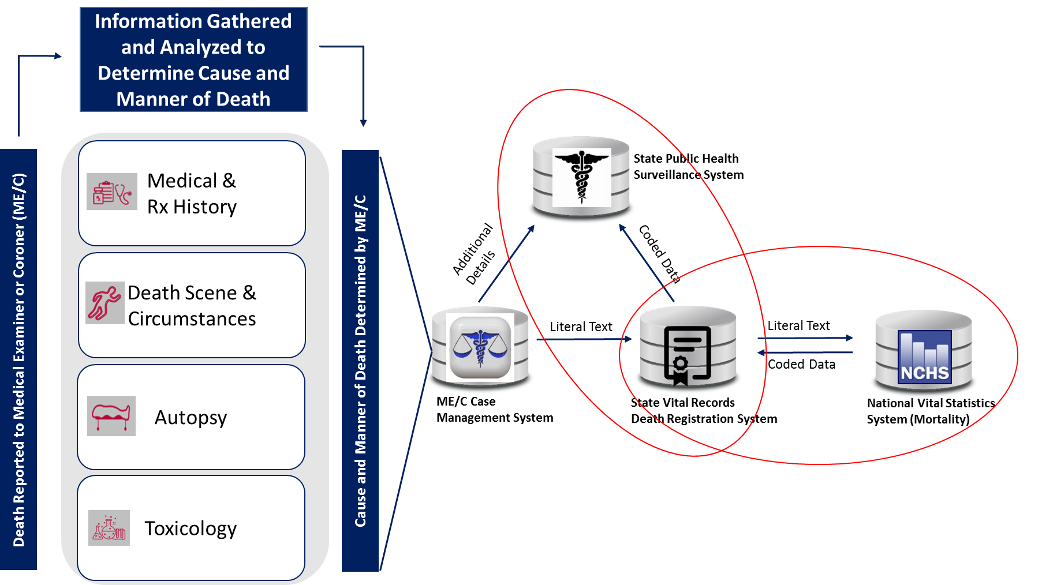
Use Case 2: Cause of Death Data Reported to State BioSense, SUDORS, etc.

Slide 7
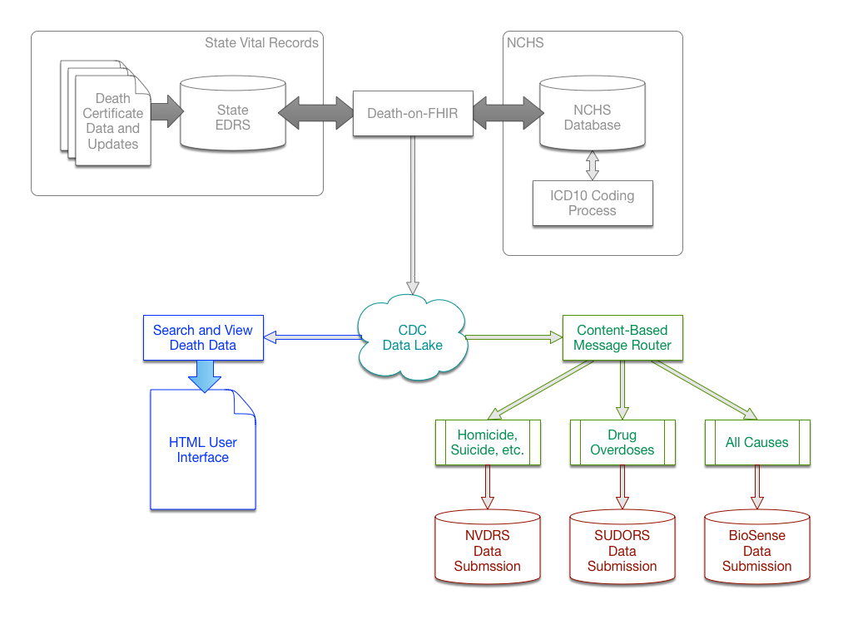
Mortality Data Handling System

Slide 8
ECPaaS and Microservices Used
Data Lake
Object microservice
Storage microservice
Indexing microservice
Kibana search user interface
ECPaaS
Content-Based Message Router
Test Framework
BioSense REST Data Submission Service
NVDRS REST Data Submission Service

